Slide 1

Credit Profile Analysis & Predictive Insights Analyze customer credit profiles and provide insights.

Slide 2

1. Data Overview 2. Data Cleaning and Outlier Analysis 3. Exploratory Data Analysis (EDA) 4. Credit Score Categories Analysis 5. Predictive Analysis & Insights 6. Conclusion
Agenda

Slide 3


Column’s description
Customer_ID : Represents a unique identification of a person Age : Represents the age of the person
Occupation : Represents the occupation of the person Annual_Income : Represents the annual income of the person
Monthly_Inhand_Salary : Represents the monthly base salary of a person Delay_from_due_date : Represents the average number of days delayed from the payment date Num_of_Delayed_Payment : Represents the average number of payments delayed by a person Credit_Mix : Represents the classification of the mix of credits
Outstanding_Debt : Represents the remaining debt to be paid (in USD) Credit_Utilization_Ratio : Represents the utilization ratio of credit card Credit_History_Age : Represents the age of credit history of the person Payment_of_Min_Amount : whether only the minimum amount was paid by the person Total_EMI_per_month : Represents the monthly EMI payments (in USD) Payment_Behaviour : Represents the payment behavior of the customer (in USD) Monthly_Balance : Represents the monthly balance amount of the customer (in USD) Credit_Score : Represents the bracket of credit score (Poor, Standard, Good)

Slide 4
Column’s description
Customer_ID : Represents a unique identification of a person
Age : Represents the age of the person
Occupation : Represents the occupation of the person
Annual_Income : Represents the annual income of the person
Monthly_Inhand_Salary : Represents the monthly base salary of a person
Delay_from_due_date : Represents the average number of days delayed from the payment date
Num_of_Delayed_Payment : Represents the average number of payments delayed by a person Credit_Mix : Represents the classification of the mix of credits
Outstanding_Debt : Represents the remaining debt to be paid (in USD)
Credit_Utilization_Ratio : Represents the utilization ratio of credit card Credit_History_Age : Represents the age of credit history of the person Payment_of_Min_Amount : whether only the minimum amount was paid by the person Total_EMI_per_month : Represents the monthly EMI payments (in USD) Payment_Behaviour : Represents the payment behavior of the customer (in USD) Monthly_Balance : Represents the monthly balance amount of the customer (in USD) Credit_Score : Represents the bracket of credit score (Poor, Standard, Good)

Slide 5
Data Cleaning and Outlier Analysis
All the data cleaning has been done with the combination of KNNImputer, random choice, mean imputation, and forward fill that ensured that missing data was addressed according to the type of variable and the specific context of the dataset.
These methods maintained the integrity of the data, preserved relationships between variables, and ensured that the dataset was ready for further analysis and modeling.
The data cleaning process was efficient, with appropriate handling of missing values based on data type and context, ensuring minimal bias and distortion.
Outlier analysis has been done with the help of boxplot by using mean and standard deviation.

Slide 6
Exploratory
Data Analysis (EDA)
Customer demographics and financial information Customer demographics and financial information group by credit scores
Customer financial information group by payment behavior

Slide 7
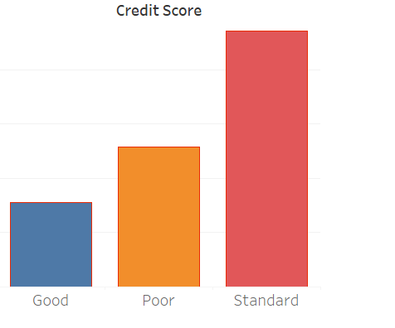
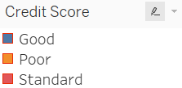
1. Customer demographics
Customer credit score distribution
Standard Poor Good

Slide 8
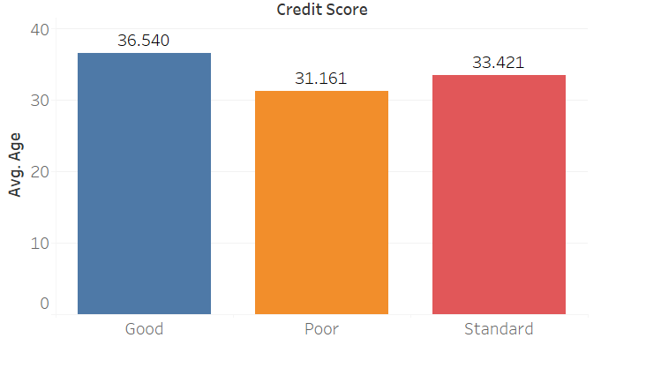
2. Customer demographics and financial information group by credit scores
Age and credit score
Good: Average age of around 37 years Poor: Average age of around 31 years
Standard: Average age of around 33 years

Slide 9
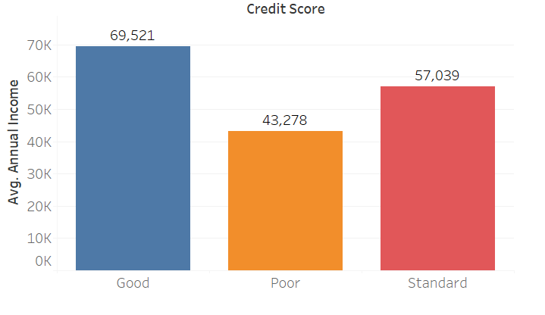
2. Customer demographics and financial information group by credit scores
Annual income and credit score
Good: Average annual income of around $69,500 Poor: Average annual income of around $43,300 Standard: Average annual income of around $57,000

Slide 10
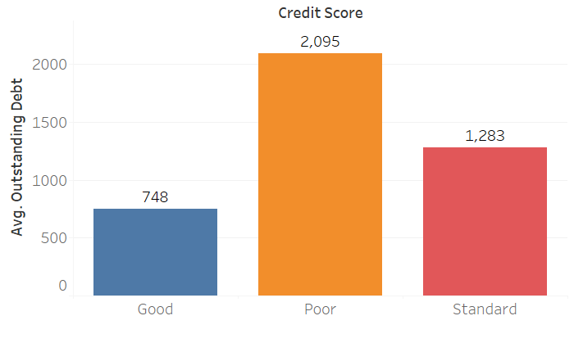
2. Customer demographics and financial information group by credit scores
Outstanding debt and credit score
Good: Average outstanding debt of around $750
Poor: Average outstanding of around $2100 Standard: Average outstanding of around
$1300

Slide 11

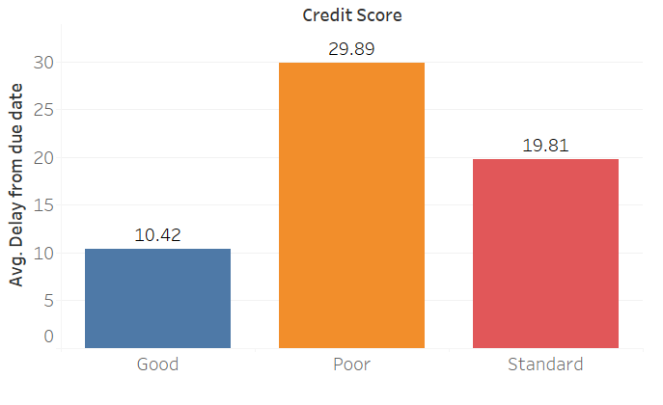
2. Customer demographics and financial
information group by credit scores
Number of days delayed from the payment date and credit score
Good: Average number of days delayed from the payment date of around 10 days
Poor: Average number of days delayed from the payment date of around 30 days
Standard: Average number of days delayed from the payment date of around 20 days

Slide 12
2. Customer demographics and financial information group by credit scores
Good Poor Standard
Average age of around 37 years Average annual income of approximately 69,500 USD Average outstanding debt of about 750 USD
Average of around 10 days delayed from the payment date.
Average age of around 31 years Average annual income of approximately 43,300 USD Average outstanding debt of about 2,100 USD
Average of around 30 days delayed from the payment date.
Average age of around 33 years Average annual income of approximately 57,000 USD Average outstanding debt of about 1300 USD
Average of around 20 days delayed from the payment date.

Slide 13
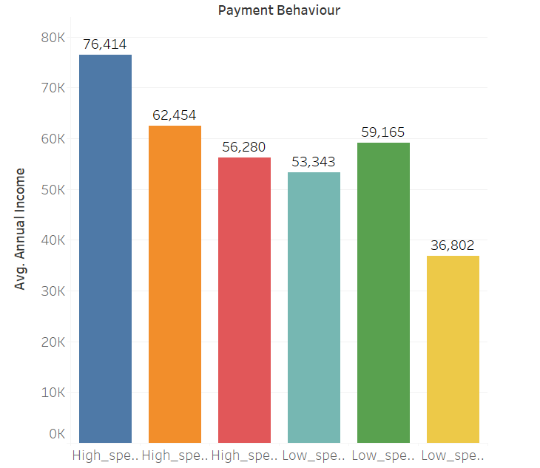
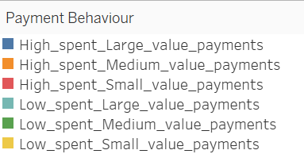
3. Customer financial information group by payment behavior

Slide 14
Thank you.

